Slide 1
Case Study of Beers and Breweries: Presented for Budweiser
Christian Castro and Max Pagan

Slide 2
Goals of this presentation
Understand what is contained in the data
Analyze basic statistics of the data
Conclude demographics and trends
Strategize further guidance

Slide 3
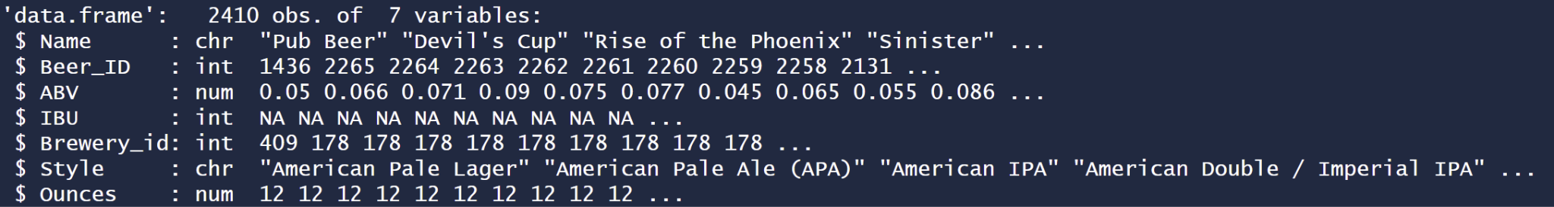
Overview of the Data
The Beers data set contains columns of
While the Breweries data set contains

Slide 4
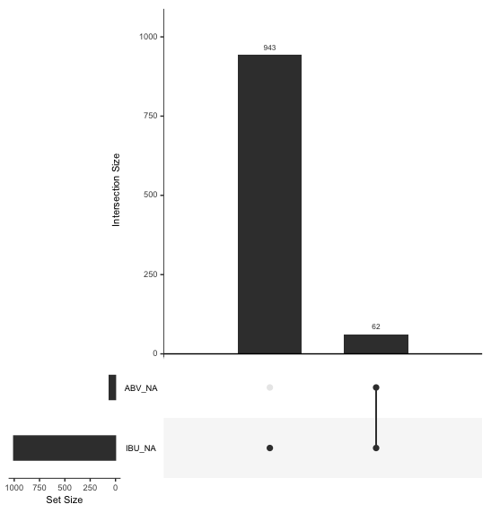
Missing values
Values were missing from IBU and ABV
1005 missing from IBU
62 missing from ABV
All missing ABV were also Missing IBU
We don’t know why ABV was missing - adjust scope & remove missing ABV datapoints
IBU values were missing completely at random - no relation to other variables
Replace missing IBU values with the median IBU
Notes:
Max

Slide 5
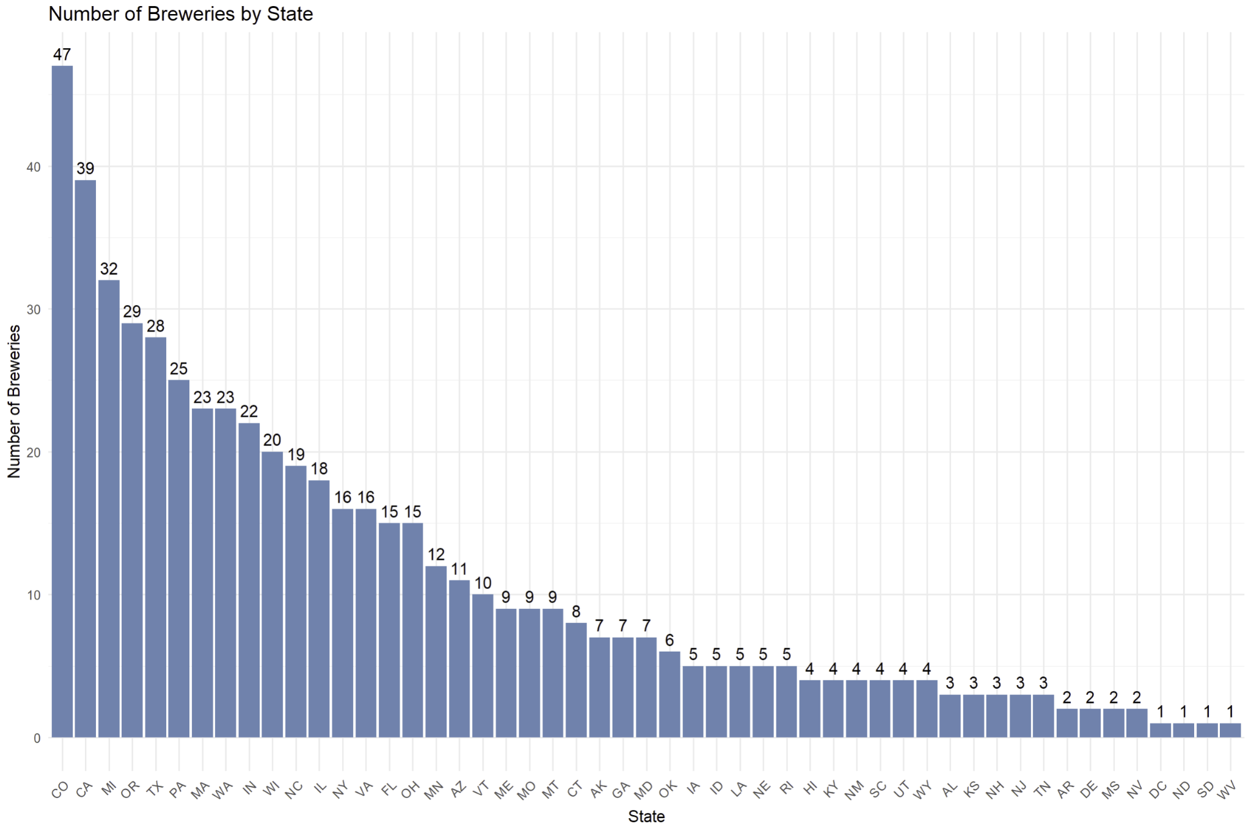
Number of Breweries by State
Visualizing the number of breweries per state, Colorado sits on top by a high margin.
Over the next few positions, there is a sharp decline in brewery count.
This provides insight into market trends and markets with a particular emphasis on craft beer

Slide 6
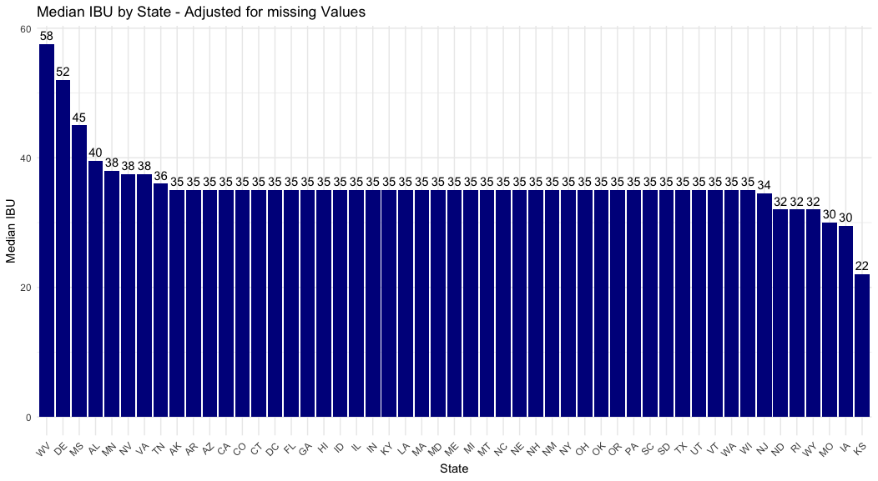
Median IBU - Adjusted
Notes:
Max

Slide 7
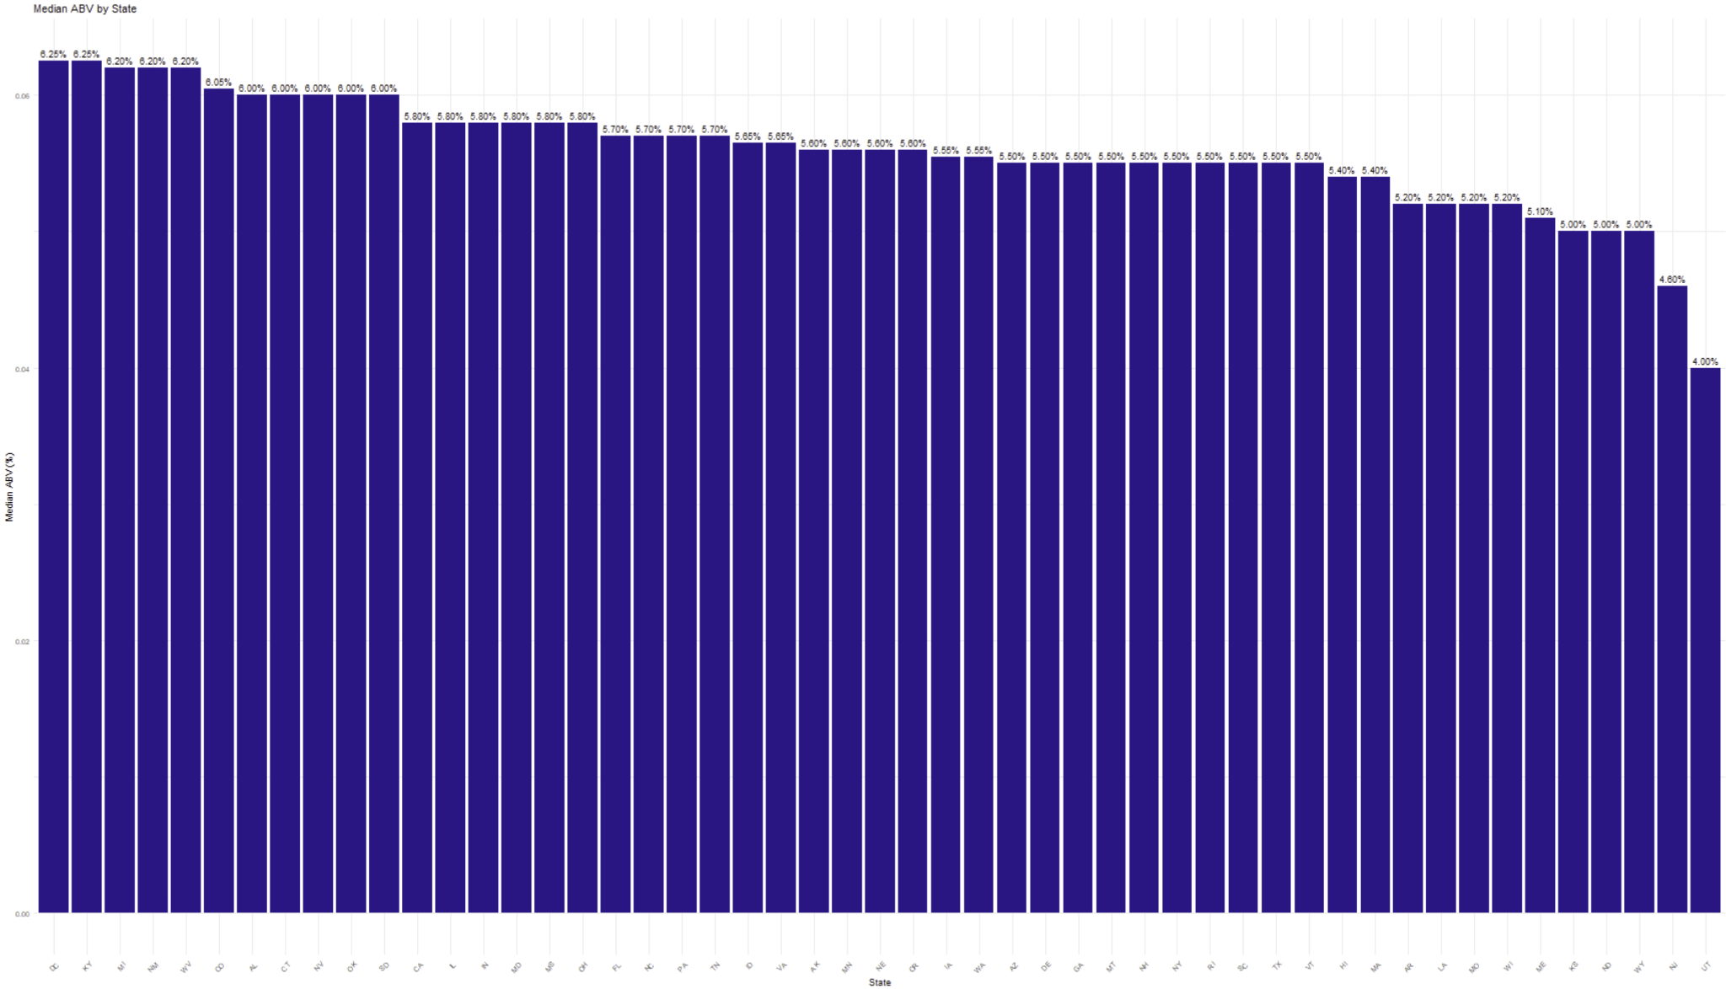
Median ABV
Notes:
Max

Slide 8
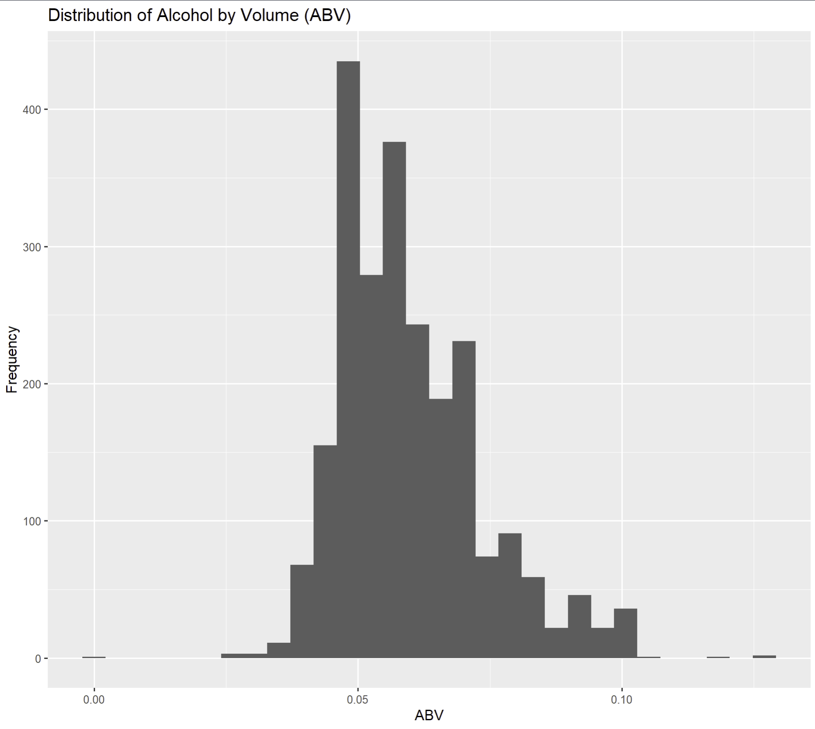
Statistics of ABV
ABV Minimum: 0.001
ABV Maximum: 0.128
ABV Median: 0.056
ABV Mean: 0.0598
The average beer in the data set has an alcohol content
Of 6.98%
The distribution of alcohol content is right skewed

Slide 9
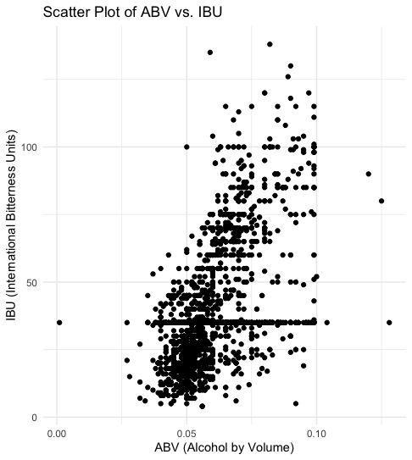
Bitterness and Alcohol Content
Based on the plotting of Alcohol By Volume (ABV) and International Bitterness Units (IBU) it appears that there is a linear relationship between the two.
Perhaps, based on ingredients and fermentation time, the alcohol content increases, but more bitter flavors are produced as well.
Notes:
Max

Slide 10
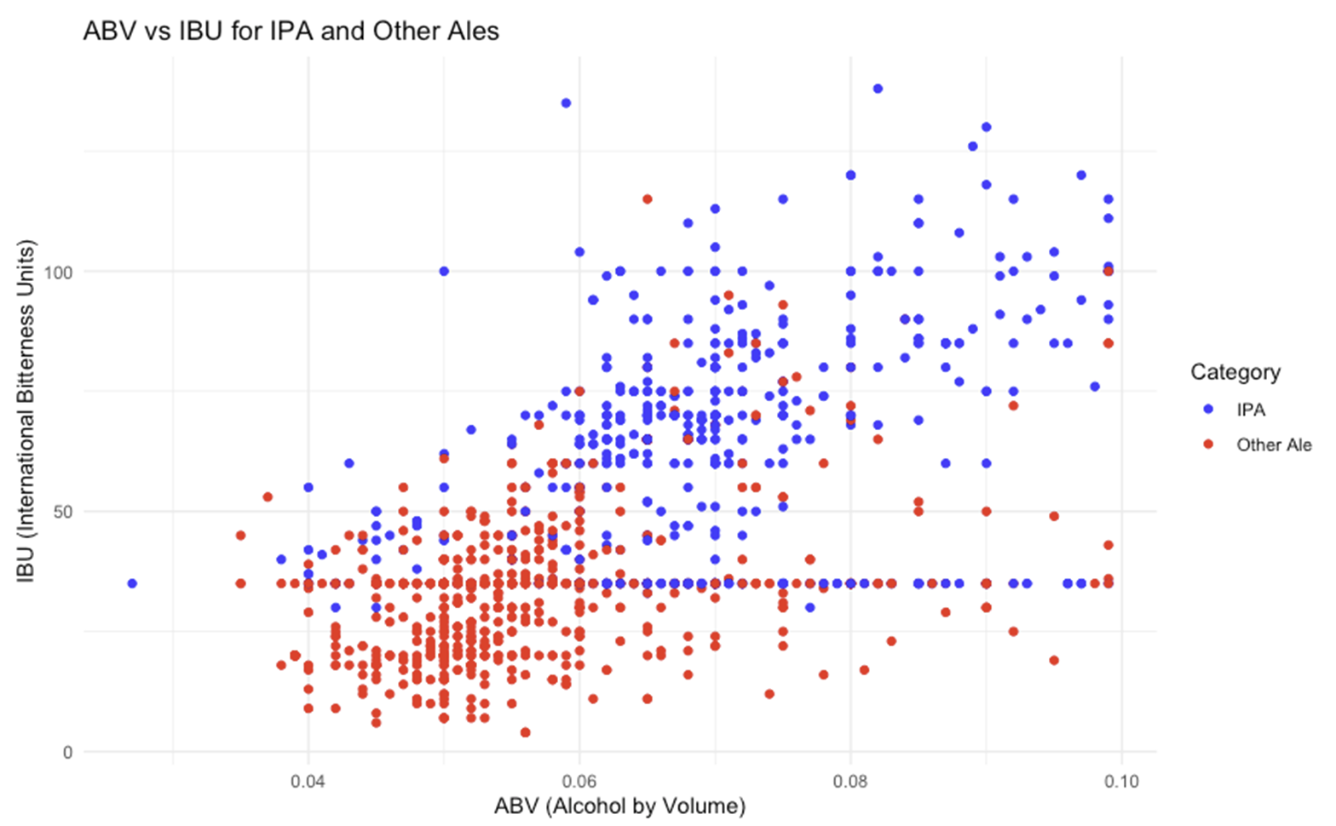
Machine Learning - IPA and other Ales
Plot of ABV vs IBU for Ales
Could we determine if an ale is an IPA based on its ABV and IBU? We trained a machine learning model to do just that.
Notes:
Max

Slide 11
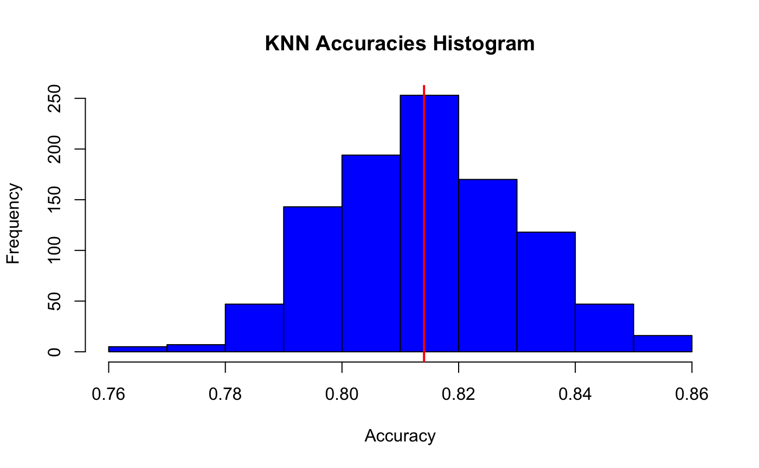
KNN analysis
Based on the plot, we trained a machine learning model to predict if an ale was an IPA or not.
The model had an average overall accuracy of 81.4%
The model's ability to correctly identify IPAs was 72.9%
The model's ability to correctly identify ‘other ales’ was 86.5%
Could be used to influence marketing decisions - even when not accurate in classifying a beer
“Hey IPA lovers, try this new ale instead, with just the right amount of bitterness!”
Notes:
Max

Slide 12
Further Guidance
Based on the data, our team sought the correlation between ABV and IBU
The correlation coefficient is 0.6706
There is evidence that an increase in ABV is associated with an increase in IBU.

Slide 13
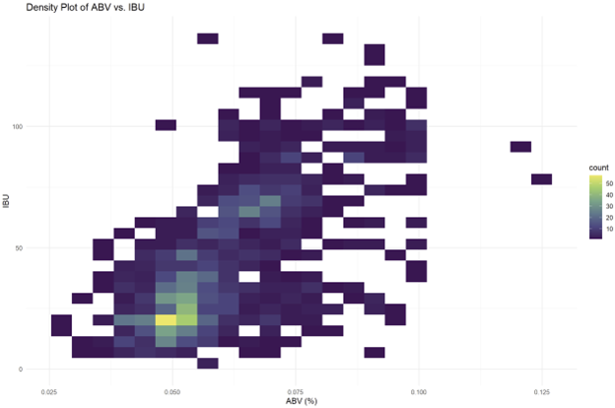
Data: Visualized
In order to more comprehensively understand these statistics, we created a density plot of IBU vs ABV
The mean ABV is 5.98%
The mean IBU is 42.71

Slide 14
The Path Forward
Budweiser should make a push towards focusing on smaller subsidiaries that can outproduce and outperform other craft beers at the popular intersections of IBU and ABV
Further research and marketing data is needed to provide a more in-depth strategy, but this provides direction for the future

Slide 15
Thank you!
Youtube link: https://youtu.be/HuLCcE9JvkE?si=WM-SxZdmdHU9OFUm

